Slide 1
DATA STRUCTURES
BOOLEAN ALGEBRA

Slide 2
What Is Boolean Algebra?
Boolean algebra is a division of mathematics that deals with operations on logical values and incorporates binary variables. Boolean algebra traces its origins to an 1854 book by mathematician George Boole.1
The distinguishing factor of Boolean algebra is that it deals only with the study of binary variables. Most commonly Boolean variables are presented with the possible values of 1 ("true") or 0 ("false"). Variables can also have more complex interpretations, such as in set theory. Boolean algebra is also known as binary algebra.

Slide 3
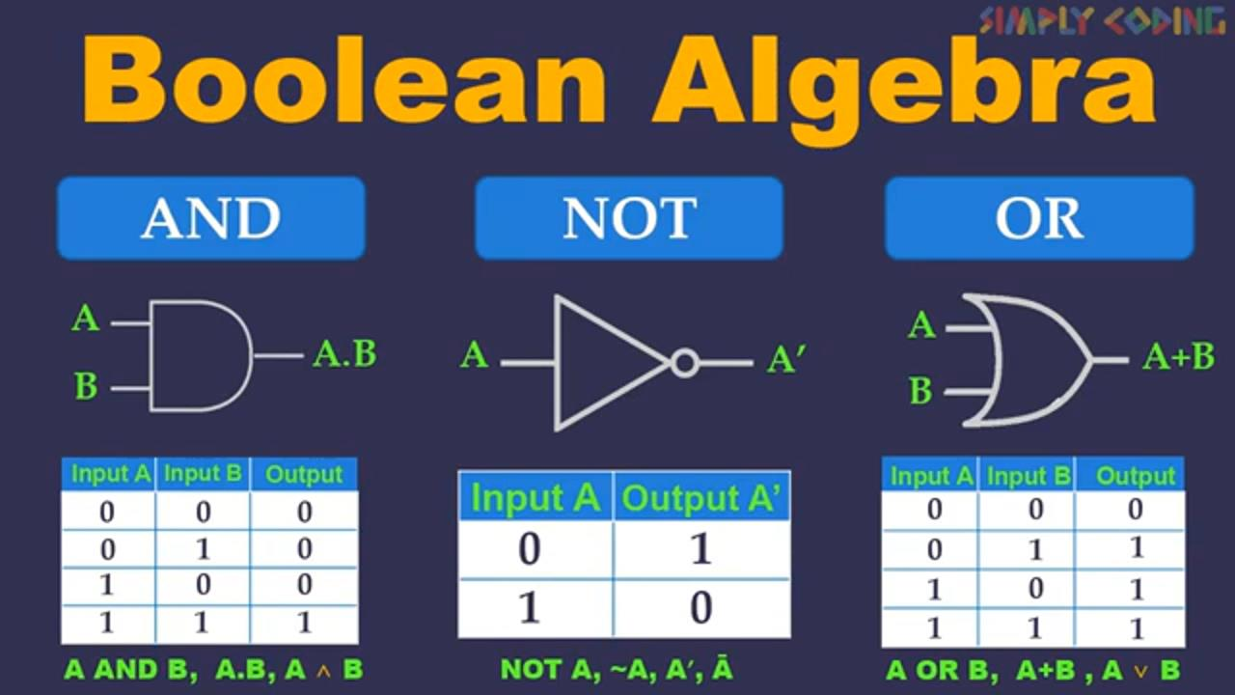
BOOLEAN EXPRESSION

Slide 4
Understanding Boolean Algebra
Boolean algebra is different from elementary algebra as the latter deals with numerical operations and the former deals with logical operations. Elementary algebra is expressed using basic mathematical functions, such as addition, subtraction, multiplication, and division, whereas Boolean algebra deals with conjunction, disjunction, and negation.
The concept of Boolean algebra was first introduced by George Boole in his book "The Mathematical Analysis of Logic," and further expanded upon in his book "An Investigation of the Laws of Thought."1 Since its concept has been detailed, Boolean algebra's primary use has been in computer programming languages. Its mathematical purposes are used in set theory and statistics.

Slide 5
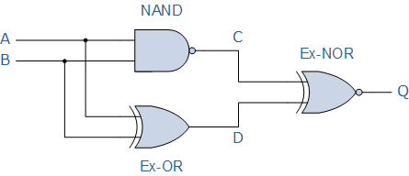
Boolean Algebra Example
Construct a Truth Table for the logical functions at points C, D and Q in the following circuit and identify a single logic gate that can be used to replace the whole circuit.
First observations tell us that the circuit consists of a 2-input NAND gate, a 2-input EX-OR gate and finally a 2-input EX-NOR gate at the output. As there are only 2 inputs to the circuit labelled A and B, there can only be 4 possible combinations of the input ( 2² ) and these are: 0-0, 0-1, 1-0 and finally 1-1. Plotting the logical functions from each gate in tabular form will give us the following truth table for the whole of the logic circuit below.
From the truth table above, column C represents the output function generated by the NAND gate, while column D represents the output function from the Ex-OR gate. Both of these two output expressions then become the input condition for the Ex-NOR gate at the output.
It can be seen from the truth table that an output at Q is present when any of the two inputs A or B are at logic 1. The only truth table that satisfies this condition is that of an OR Gate. Therefore, the whole of the above circuit can be replaced by just one single 2-input OR Gate.
Inputs |  | Output at
A | B | C | D | Q
0 | 0 | 1 | 0 | 0
0 | 1 | 1 | 1 | 1
1 | 0 | 1 | 1 | 1
1 | 1 | 0 | 0 | 1

Slide 6


